Slide 1
Distributed Computer Systems
CT024-3-3-DCOMS and Version VC1
Introduction & RPC

Slide 2
Lecturer Introduction
Name : Umapathy
Email: umapathy.eaganathan@staffemail.apu.edu.my

Slide 3
Prerequisites for this module
CT043-3-1 Introduction to Networking and CT038-3-2 and Object Oriented Development with Java or equivalent
Notes:
3

Slide 4
Aims of the module
Remote Method Invocation (RMI), Common Object Request Broker Architecture (CORBA), and Component Object Model (COM). Students will learn how distributed systems functioning in three tier network.
Notes:
4

Slide 5
Topic & Structure of The Lesson
Introduction
Remote Procedure Call
Remote Method Invocation (RMI)

Slide 6
Course Learning Outcomes
Evaluate various distributed technologies to improve the quality of distributed enterprise applications based on the given case study (C5, PLO1)
Identify the future developments in distributed systems technology and standards with organizaton needs based on research. (A4, PLO6)
Propose an appropriate programming language and system facilities to develop distributed and fault-tolerant applications (A5, PLO5)

Slide 7
Mapping of CLOs with MOEs Domain
PLO1 – Knowledge
PLO5 – Social Skills, Teamwork and Responsibilities
PLO6 – Values, Attitudes and Professionalism

Slide 8
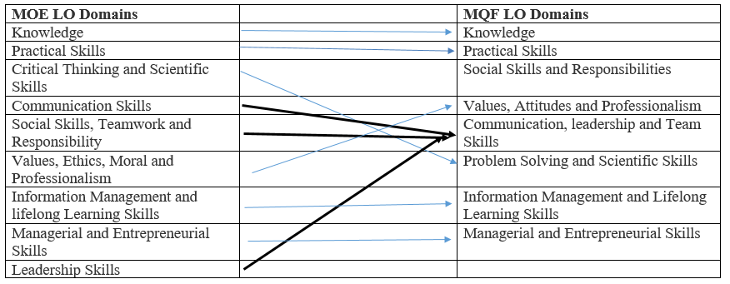
MQF and MOE Domains

Slide 9
Teaching Strategies
Lecture
Tutorial
Case Study (Individual and Group)

Slide 10
Assessment Methods
Final Exam (40%) : CLO1
Group Assignment (60%)
Research & Implementation : CLO2, CLO3

Slide 11
Methods of Delivery
Hence,
We are now moving from the traditional topic based teaching to outcome-based education

Slide 12
Outcomes Based Education (OBE)
OBE is education based on producing particular educational outcomes that:
Focus on what students can actually do after they are taught
Expect all learners / students to successfully achieve particular (sometimes minimum) level of knowledge and abilities.

Slide 13
So…What is OBE?
It’s
NOT
What we want to teach,
It’s
What You should learn

Slide 14
Student Learning Time (SLT)
Course Credit Value: 3
Total Learning Hours:
Lecture: 18 hours per semester
Tutorial / Case Study : 24 hours per semester
Independent Learning Time: 76 hours per semester

Slide 15
Learning Outcomes
At the end of this topic, You should be able to
Understand the key characteristics, basic design issues, user requirements
Understand how Remote Procedure Call uses in DS
Understand the concept of Remote Method Invocation, stub/skeleton, IIOP in DS

Slide 16
Key Terms You Must Be Able To Use
If you have mastered this topic, you should be able to use the following terms correctly in your assignments and exams:

Slide 17
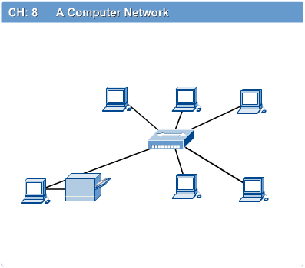
INTRODUCTION TO COMPUTER NETWORKS
Computer network connects two or more autonomous computers.
The computers can be geographically located anywhere.

Slide 18
Networking
Connecting computers to form a Local Area Network (LAN)
Here devices sharing of
Hardware
Software and
Information
LAN is a collection of computers connected together in a NW which less than 1000 computers

Slide 19
LAN, MAN and WAN
Network in small geographical Area (Room, Building or a Campus) is called LAN (Local Area Network)
Network in a City is call MAN (Metropolitan Area Network)
Network spread geographically (Country or across Globe) is called WAN (Wide Area Network)

Slide 20
Applications of Networks
Resource Sharing
Hardware (computing resources, disks, printers)
Software (application software)
Information Sharing
Easy accessibility from anywhere (files, databases)
Search Capability (WWW)
Communication
Email
Message broadcast
Remote computing
Distributed processing (GRID Computing)

Slide 21
Internetworks & Intranetworks
A network of networks called internetwork that is a networked collection of LAN.
More than one floor in a business or multiple buildings, campus environment

Slide 22
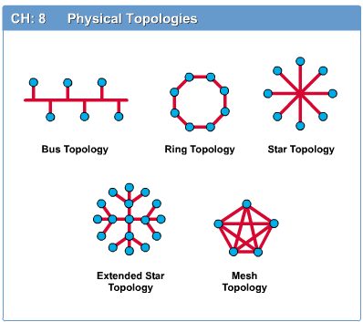
Network Topology
The network topology defines the way in which computers, printers, and other devices are connected. A network topology describes the layout of the wire and devices as well as the paths used by data transmissions.

Slide 23
WAN
Spans miles of distance
Two or more separate locations
Down the road or across the world
Millions of machines in world wide web
Simple network needs
Medium to carry data, Adapter (NIC), Protocol, Client / Server Software

Slide 24
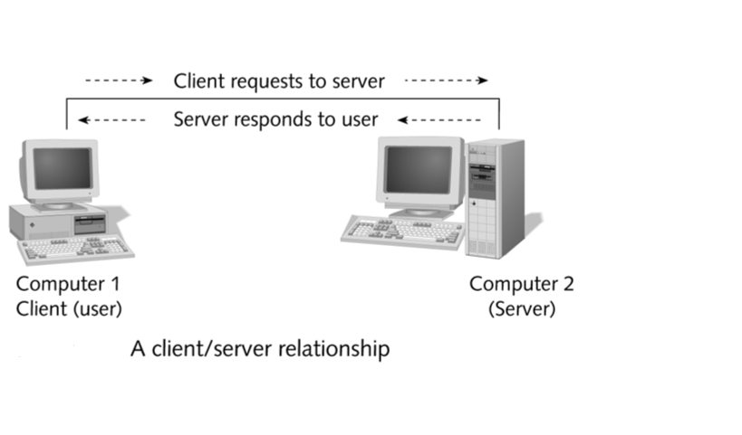
Networking Terminology

Slide 25
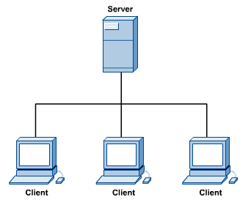
Computers: Clients and Servers
In a client/server network arrangement, network services are located in a dedicated computer whose only function is to respond to the requests of clients.
The server contains the file, print, application, security, and other services in a central computer that is continuously available to respond to client requests.

Slide 26
Medium for data communication
Metallic cable coaxial
Twisted pair cable
Fiber optic cable
Wireless
NIC (Network Interface Card)
Physical link between machine and the network
Connection between machine and the medium
Also knows as network adapter

Slide 27
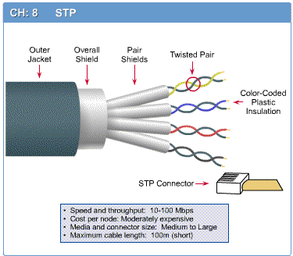
Networking media can be defined simply as the means by which signals (data) are sent from one computer to another (either by cable or wireless means).

Slide 28
Network Components
Physical Media
Interconnecting Devices
Computers
Networking Software
Applications

Slide 29
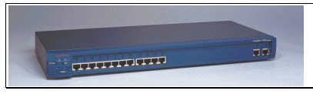
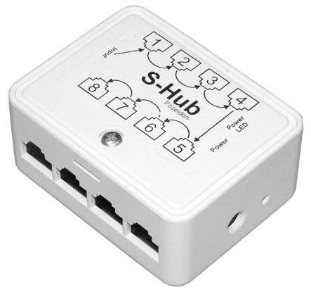
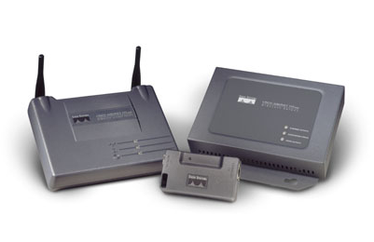
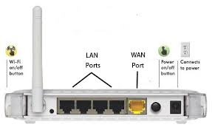
Networking Devices
HUB, Switches, Routers, Wireless Access Points, Modems etc.

Slide 30
Protocols
Common set of communication rules
Identify oneself and others on network
Interpret signals
Begin and end network communication
Manage network information exchange
Some of the protocols are
TCP/IP for the internet
IPX/SPX & NWLINK for novel
NetBEUI for Microsoft

Slide 31
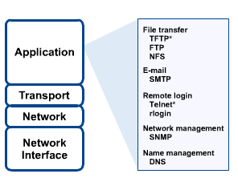
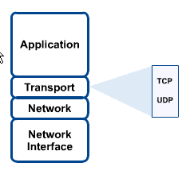
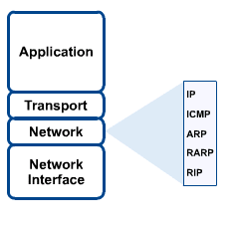
Network protocol TCP/IP

Slide 32

Applications
E-mail
Searchable Data (Web Sites)
E-Commerce
News Groups
Internet Telephony (VoIP)
Video Conferencing
Chat Groups
Instant Messengers
Internet Radio

Slide 33
Distributed Systems
Topics
What is a Distributed System?
Why Distributed Systems?
Examples of Distributed Systems
Distributed System Requirements
Transparency in Distributed Systems

Slide 34
Distributed Systems
Can think of DS as:
breaking down an application into individual computing agents
distributed over a network
work together on a cooperative task
Motivation for DC:
Scalability: can solve larger problems without larger computers
Openness and heterogeneity: applications and data may be difficult to relocate and reconfigure
Fault-tolerance: redundant processing agents for system availability

Slide 35
What Is a Distributed Ingredients of a Distributed System System?
Component-1
…
Component-n
Component-1
…
Component-m
Network OS
Network OS
Hardware
Hardware
Host-1
Host-n
Component-1
…
Component-n
Middleware
Network OS
Hardware
Host-1

Slide 36
What Is a Distributed System?
Component-1
…
Component-n
Component-1
…
Component-n
Middleware
Middleware
Network OS
Network OS
Hardware
Hardware
Host-1
Host-2
Network
Component-1
…
Component-n
Component-1
…
Component-n
Middleware
Middleware
Network OS
Network OS
Hardware
Hardware
Host-n
Host-3

Slide 37
What is a Distributed System
Distributed System Definition:
A distributed system is a collection of autonomous hosts that are connected through a computer network.
Each host executes components and operates a distribution middleware.
Middleware enables the components to coordinate their activities.
Users perceive the system as a single, integrated computing facility.

Slide 38
Why Distributed Systems?
Every application is part of your business model
must make them work together!
Payables/ Receivables
Sales
Accounting
Manufacturing
Inventory
Shipping/ Receiving
Engineering

Slide 39
Why Distributed Systems?
Application Integration and Distributed Processing are the same thing
Constructing information-sharing distributed systems from diverse sources:
heterogeneous
networked
physically disparate
multi-vendor

Slide 40
Why Distributed System?
Application Requirements
Functional
Non-Functional
Non-functional requirements drive distribution of a system
Scalability
Concurrency
Openness
Heterogeneity
Resource sharing
Fault-tolerance
Notes:
Scalability denotes the ability to accommodate a growing load in the future.
Open systems can easily be extended and modified. It is achieved by communicating using well-defined interfaces.
Heterogeneity of components can arise in the programming languages, operating systems, hardware platforms and network protocols. Component heterogeneity can be accommodated by distributed systems.
Often resources, i.e., hardware, software, and data need to be shared by more than one user. Distributed objects provide a sophisticated model of resource sharing.
Security needs to be considered when it comes to sharing
Fault-tolerance refers that operations can continue even in the presence of faults. It is achieved in distributed system by means of replication

Slide 41
Centralized vs Distributed Systems
Centralized Systems
Centralized systems have non-autonomous components
Centralized systems are often build using homogeneous technology
Multiple users share the resources of a centralized system at all times
Centralized systems have a single point of control and of failure
Distributed Systems
Distributed systems have autonomous components
Distributed systems may be built using heterogeneous technology
Distributed system components may be used exclusively
Distributed systems are executed in concurrent processes
Distributed systems have multiple points of failure

Slide 42
Advantages and Disadvantages of Distributed Systems
Advantages
Shareability
Expandability
Local autonomy
Improved performance
Improved reliability and availability
Potential cost reductions
Disadvantages
Network reliance
Complexities
Security
Multiple point of failure

Slide 43
Middleware
Software that acts as a bridge between an operating system or database and applications, especially on a network.
Middleware often sits between the operating system and applications on different servers and simplifies the development of applications that leverage services from other applications.
Software that connects two otherwise separate applications. For example, there are a number of middleware products that link a database system to a Web server. This allows users to request data from the database using forms displayed on a Web browser, and it enables the Web server to return dynamic Web pages based on the user's requests and profile.

Slide 44
History Review of Distributed Systems
Late 70’s and early 80’s: synchronous with distributed processing
Mid 80’s: no point of central control
Late 80’s: peer structure and inter-connection configuration
Later: more fine-grained distribution
Software is decomposed into components
Components can resides on different computers and be implemented with different languages

Slide 45
Examples of Distributed Systems
Video-on-Demand
Client components are used to display videos
Clients are hosted in the homes of the customers of the service
Server components load and transmit videos
Multiple servers are needed in order to scale

Slide 46
Examples of Distributed Systems
IT Service Architecture of a Swiss Bank
Service architecture consists of heterogeneous new and legacy components
Hardware platforms range from mainframes to NTs
Programming languages including Assembler, Cobol, C, C++, Java, …
Different types of middleware can be used to resolve distribution and heterogeneity
Authorization Services
Customer Information Services
Trading Services
ATM Services

Slide 47
Transparency in Distributed Systems
Distributed System Definition: A distributed system is a collection of autonomous hosts that are connected through a computer network and coordinate with each other in such a way that users perceive the system as a single and integrated computing facility.
Dimensions of transparency in DS
Access Transparency
Location Transparency
Migration Transparency
Replication Transparency
Concurrency Transparency
Scalability Transparency
Performance Transparency
Failure Transparency
Notes:
Access transparency means that the interfaces for local and remote communication are the same (Unix networked file systems)
Location transparency means that service requesters do not need to know physical component locations (NFS in unix environment, we don’t need to the ip address).
Migration transparency means that the component can be relocated without users or clients noticing it. It depends on both access and location transparency.
Replication transparency means the users and programmers do not know whether a replica or a master provides a service (a replica is a component copy that remains synchronized with its original.) Example: video-on-demand. It depends on access and location transparency
Concurrency transparency means that users and programmers are unaware that components request services concurrently. (Bank application is an example)
Scalability transparency means that users and programmers do not know how scalability of a distributed system is achieved. (The Internet is an example). It depends on replication and migration transparency.
Performance transparency means that users and programmers are unaware how good system performance is maintained. (Example: distributed version of make). It depends on replication and migration transparency.
Failure transparency means that users and programmers are unaware of how distributed systems conceal failures. It depends on concurrency and replication transparency. (Example: banking applications)

Slide 48
Location Transparency
Caller
Machine 1
Machine 2
local
call
remote
call
Implementor
Proxy

Slide 49
Remote Procedure Call (RPC)
The most common framework for newer protocols and for middleware
Used both by operating systems and by applications
NFS is implemented as a set of RPCs
DCOM, CORBA, Java RMI, etc., are just RPC systems
Fundamental idea: –
Server process exports an interface of procedures or functions that can be called by client programs
similar to library API, class definitions, etc.
Clients make local procedure/function calls
As if directly linked with the server process
Under the covers, procedure/function call is converted into a message exchange with remote server process

Slide 50
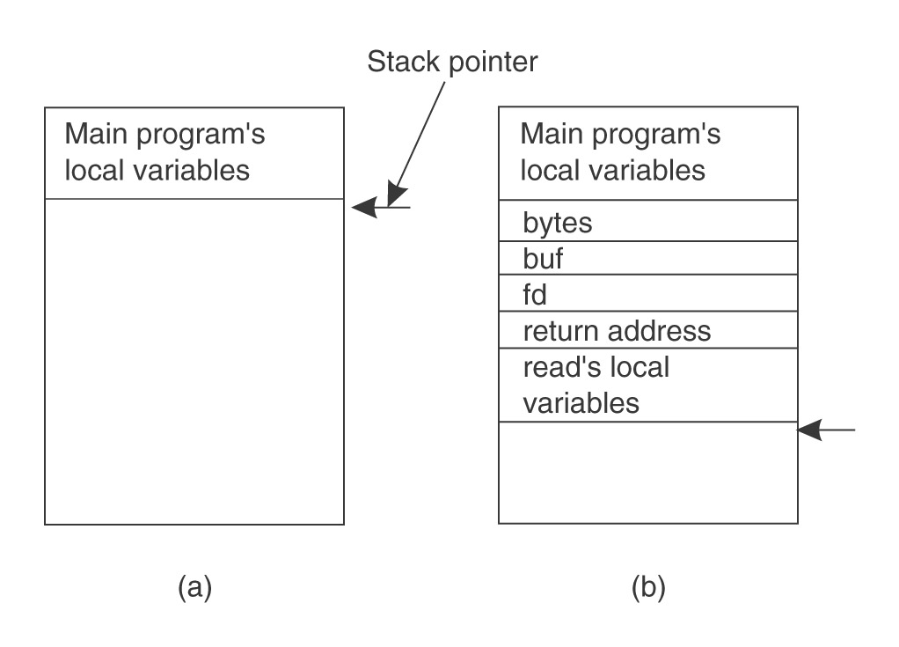
Ordinary procedure/function call
count = read(fd, buf, nbytes)

Slide 51
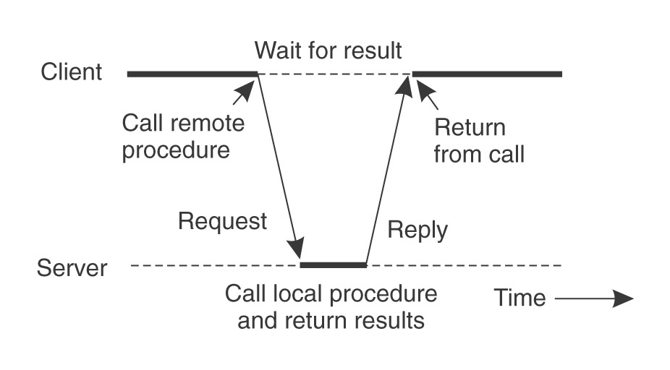
Would like to do the same if called procedure or function is on a remote server

Slide 52
Solution – a pair of stubs
Client-side stub
Looks like local server function
Same interface as local function
Bundles arguments into message, sends to server-side stub
Waits for reply, un-bundles results
returns

Slide 53
Server-side stub
Looks like local client function to server
Listens on a socket for message from client stub
Un-bundles arguments to local variables
Makes a local function call to server
Bundles result into reply message to client stub

Slide 54
Result
The hard work of building messages, formatting, uniform representation, etc., is buried in the stubs
Where it can be automated!
Client and server designers can concentrate on the semantics of application
Programs behave in familiar way

Slide 55
RPC Model
A server defines the service interface using an interface definition language (IDL)
the IDL specifies the names, parameters, and types for all client-callable server procedures
A stub compiler reads the IDL declarations and produces two stub functions for each server function
Server-side and client-side

Slide 56
RPC Model (continued)
Linking:–
Server programmer implements the service’s functions and links with the server-side stubs
Client programmer implements the client program and links it with client-side stubs
Operation:–
Stubs manage all of the details of remote communication between client and server

Slide 57
RPC Stubs
A client-side stub is a function that looks to the client as if it were a callable server function
I.e., same API as the server’s implementation of the function
A server-side stub looks like a caller to the server
I.e., like a hunk of code invoking the server function
The client program thinks it’s invoking the server
but it’s calling into the client-side stub
The server program thinks it’s called by the client
but it’s really called by the server-side stub
The stubs send messages to each other to make the RPC happen transparently (almost!)

Slide 58
Marshalling Arguments
Marshalling is the packing of function parameters into a message packet
the RPC stubs call type-specific functions to marshal or unmarshal the parameters of an RPC
Client stub marshals the arguments into a message
Server stub unmarshals the arguments and uses them to invoke the service function
on return:
the server stub marshals return values
the client stub unmarshals return values, and returns to the client program

Slide 59
Java Remote Object Invocation (RMI)
Overview of RMI
Java RMI allowed programmer to execute remote function class using the same semantics as local functions calls.
Local Machine (Client)
SampleServer remoteObject;
int s;
…
s = remoteObject.sum(1,2);
System.out.println(s);
Remote Machine (Server)
public int sum(int a,int b) {
return a + b;
}
1,2
3

Slide 60
The General RMI Architecture
The server must first bind its name to the registry
The client lookup the server name in the registry to establish remote references.
The Stub serializing the parameters to skeleton, the skeleton invoking the remote method and serializing the result back to the stub.

Slide 61
The Stub and Skeleton
A client invokes a remote method, the call is first forwarded to stub.
The stub is responsible for sending the remote call over to the server-side skeleton
The stub opening a socket to the remote server, marshaling the object parameters and forwarding the data stream to the skeleton.
A skeleton contains a method that receives the remote calls, unmarshals the parameters, and invokes the actual remote object implementation.

Slide 62
Remote Method Invocation
Remote method invocation(RMI) allow a java object to invoke method on an object running on another machine. RMI provide remote communication between java program. RMI is used for building distributed application.

Slide 63
Concept of RMI
A RMI application can be divided into two part, Client program and Server program. A Server program creates some remote object, make their references available for the client to invoke method on it. A Client program make request for remote objects on server and invoke method on them. Stub and Skeleton are two important object used for communication with remote object.

Slide 64
Stub and Skeleton
Stub act as a gateway for Client program. It resides on Client side and communicate with Skeleton object. It establish the connection between remote object and transmit request to it.
Skeleton object resides on server program. It is responsible for passing request from Stub to remote object.

Slide 65
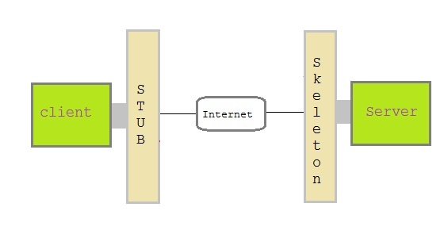
Stub and Skeleton

Slide 66
Creating a simple RMI application
Define a remote interface.
Implementing remote interface.
create and start remote application
create and start client application

Slide 67
Define a remote interface
A remote interface specifies the methods that can be invoked remotely by a client. Clients program communicate to remote interfaces, not to classes implementing it. To be a remote interface, a interface must extend the Remote interface of java.rmi package.

Slide 68
Remote Interface
import java.rmi.*;
public interface AddServerInterface extends Remote
{
public int sum(int a,int b);
}

Slide 69
Implementation of remote interface
For implementation of remote interface, a class must either extend UnicastRemoteObject or use exportObject() method of UnicastRemoteObject class.

Slide 70
import java.rmi.*;
import java.rmi.server.*;
public class Adder extends UnicastRemoteObject
implements AddServerInterface
{
Adder()throws RemoteException
{
super();
}
public int sum(int a,int b)
{
return a+b;
}
}

Slide 71
Create AddServer and host rmi service
You need to create a server application and host rmi service Adder in it.
This is done using rebind() method of java.rmi.Naming class.
rebind() method take two arguments, first represent the name of the object reference and second argument is reference to instance of Adder

Slide 72
import java.rmi.*;
import java.rmi.registry.*;
public class AddServer
{
public static void main(String args[])
{ try
{
AddServerInterface addService=new Adder();
Naming.rebind("AddService",addService); //addService object
is hosted with name AddService.
}
catch(Exception e)
{
System.out.println(e);
}
}
}

Slide 73
Create Client Application
Client application contains a java program that invokes the lookup() method of the Naming class.
This method accepts one argument, the rmi URL and returns a reference to an object of type AddServerInterface. All remote method invocation is done on this object.

Slide 74
import java.rmi.*;
public class Client
{
public static void main(String args[])
{
try
{
AddServerInterface st=(AddServerInterface)Naming.lookup("rmi://"+args[0]+"/AddService");
System.out.println(st.sum(25,8));
}
catch(Exception e)
{
System.out.println(e);
}
}
}

Slide 75
Execution
Compile all the files using javac
Start rmi registry
Run server
Run client
Output is : 33

Slide 76
Write a RMI application to reverse the given string .Write all interfaces and required classes
import java.rmi.*; public interface StrRev extends Remote { public String reverse(String str) throws RemoteException; }

Slide 77
import java.rmi.*; import java.rmi.server.*; import java.util.*; public class StrRev_Impli extends UnicastRemoteObject implements StrRev { public StrRev_Impli() throws RemoteException {} public String reverse(String str) throws RemoteException { String str1=""; for(int i=str.length()-1;i>=0;i--) str1=str1+str.charAt(i); return (str1); } }

Slide 78
import java.rmi.*; import java.net.*; public class StrRev_Server { public static void main(String args[]) { try { StrRev_Impli strimpli=new StrRev_Impli(); Naming.rebind("RmiReverse",strimpli); } catch(Exception ex){} } }

Slide 79
import java.io.*; import java.rmi.*; import java.net.*; public class StrRev_Client { public static void main(String args[]) { try { String url="rmi://127.0.0.1/RmiReverse"; StrRev strf=(StrRev)Naming.lookup(url); BufferedReader br=new BufferedReader(new InputStreamReader(System.in)); System.out.println("Enter String to reverse : "); String str=br.readLine(); System.out.println("Reverse of entered string is "+strf.reverse(str)); } catch(Exception ex){} } }

Slide 80
Write a RMI application to check whether the given number is Prime or not . Write all interfaces and required classes.
import java.rmi.*; public interface Prime extends Remote { public int check_prime(int no) throws RemoteException; }

Slide 81
import java.rmi.*; import java.net.*; public class Prime_server { public static void main(String args[]) { try { Prime_Impli primpli=new Prime_Impli(); Naming.rebind("RmiPrime",primpli); } catch(Exception ex){} } }

Slide 82
import java.io.*; import java.rmi.*; import java.net.*; public class Prime_client { public static void main(String args[]) { try { String url="rmi://127.0.0.1/RmiPrime"; Prime intf=(Prime)Naming.lookup(url); BufferedReader br=new BufferedReader(new InputStreamReader(System.in)); System.out.println("Enter No : "); int no=Integer.parseInt(br.readLine()); int x=intf.check_prime(no); if(x==0) System.out.println(no+" is prime number"); else System.out.println(no+" is not prime number"); } catch(Exception ex){} } }

Slide 83
Steps for Developing an RMI System
1. Define the remote interface
2. Develop the remote object by implementing the remote interface.
3. Develop the client program.
4. Compile the Java source files.
5. Generate the client stubs and server skeletons.
6. Start the RMI registry.
7. Start the remote server objects.
8. Run the client

Slide 84
Step 1: Defining the Remote Interface
To create an RMI application, the first step is the defining of a remote interface between the client and server objects.
/* SampleServer.java */
import java.rmi.*;
public interface SampleServer extends Remote
{
public int sum(int a,int b) throws RemoteException;
}

Slide 85
Step 2: Develop the remote object and its interface
The server is a simple unicast remote server.
Create server by extending java.rmi.server.UnicastRemoteObject.
The server uses the RMISecurityManager to protect its resources while engaging in remote communication.
/* SampleServerImpl.java */
import java.rmi.*;
import java.rmi.server.*;
import java.rmi.registry.*;
public class SampleServerImpl extends UnicastRemoteObject
implements SampleServer
{
SampleServerImpl() throws RemoteException
{
super();
}

Slide 86
Step 2: Develop the remote object and its interface
Implement the remote methods
/* SampleServerImpl.java */
public int sum(int a,int b) throws RemoteException
{
return a + b;
}
}
The server must bind its name to the registry, the client will look up the server name.
Use java.rmi.Naming class to bind the server name to registry. In this example the name call “SAMPLE-SERVER”.
In the main method of your server object, the RMI security manager is created and installed.

Slide 87
Step 2: Develop the remote object and its interface
/* SampleServerImpl.java */
public static void main(String args[])
{
try
{
System.setSecurityManager(new RMISecurityManager());
//set the security manager
//create a local instance of the object
SampleServerImpl Server = new SampleServerImpl();
//put the local instance in the registry
Naming.rebind("SAMPLE-SERVER" , Server);
System.out.println("Server waiting.....");
}
catch (java.net.MalformedURLException me) {
System.out.println("Malformed URL: " + me.toString()); }
catch (RemoteException re) {
System.out.println("Remote exception: " + re.toString()); }
}

Slide 88
Step 3: Develop the client program
In order for the client object to invoke methods on the server, it must first look up the name of server in the registry. You use the java.rmi.Naming class to lookup the server name.
The server name is specified as URL in the from ( rmi://host:port/name )
Default RMI port is 1099.
The name specified in the URL must exactly match the name that the server has bound to the registry. In this example, the name is “SAMPLE-SERVER”
The remote method invocation is programmed using the remote interface name (remoteObject) as prefix and the remote method name (sum) as suffix.

Slide 89
Step 3: Develop the client program
import java.rmi.*;
import java.rmi.server.*;
public class SampleClient
{
public static void main(String[] args)
{
// set the security manager for the client
System.setSecurityManager(new RMISecurityManager());
//get the remote object from the registry
try
{
System.out.println("Security Manager loaded");
String url = "//localhost/SAMPLE-SERVER";
SampleServer remoteObject = (SampleServer)Naming.lookup(url);
System.out.println("Got remote object");
System.out.println(" 1 + 2 = " + remoteObject.sum(1,2) );
}
catch (RemoteException exc) {
System.out.println("Error in lookup: " + exc.toString()); }
catch (java.net.MalformedURLException exc) {
System.out.println("Malformed URL: " + exc.toString()); }
catch (java.rmi.NotBoundException exc) {
System.out.println("NotBound: " + exc.toString());
}
}
}

Slide 90
Step 4 & 5: Compile the Java source files & Generate the client stubs and server skeletons
Assume the program compile and executing at elpis on ~/rmi
Once the interface is completed, you need to generate stubs and skeleton code. The RMI system provides an RMI compiler (rmic) that takes your generated interface class and procedures stub code on its self.
elpis:~/rmi> set CLASSPATH=”~/rmi”
elpis:~/rmi> javac SampleServer.java
elpis:~/rmi> javac SampleServerImpl.java
elpis:~/rmi> rmic SampleServerImpl
elpis:~/rmi> javac SampleClient.java

Slide 91
Step 6: Start the RMI registry
The RMI applications need install to Registry. And the Registry must start manual by call rmiregisty.
The rmiregistry us uses port 1099 by default. You can also bind rmiregistry to a different port by indicating the new port number as : rmiregistry <new port>
elpis:~/rmi> rmiregistry
Remark: On Windows, you have to type in from the command line:
> start rmiregistry

Slide 92
Steps 7 & 8: Start the remote server objects & Run the client
Once the Registry is started, the server can be started and will be able to store itself in the Registry.
Because of the grained security model in Java 2.0, you must setup a security policy for RMI by set java.security.policy to the file policy.all
elpis:~/rmi> java –Djava.security.policy=policy.all SampleServerImpl
elpis:~/rmi> java –Djava.security.policy=policy.all SampleClient

Slide 93
Summary
Distributed systems
Centralized systems vs distributed systems
The need for distributed systems --- application’s non-functional requirements
Transparencies
Dependencies among different dimensions of transparencies
RPC Model
RPC Stubs
Marshalling Arguments
RMI

Slide 94
Question and answer session
Q & A

Slide 95
What we will cover next
Processes and Threads

